Slide 1
Internet of Things (IoT)
CSE 315
Peripherals & Interfacing
Courtesy:
Abdullah Al Omar
Lecturer, CSE, UAP

Slide 2
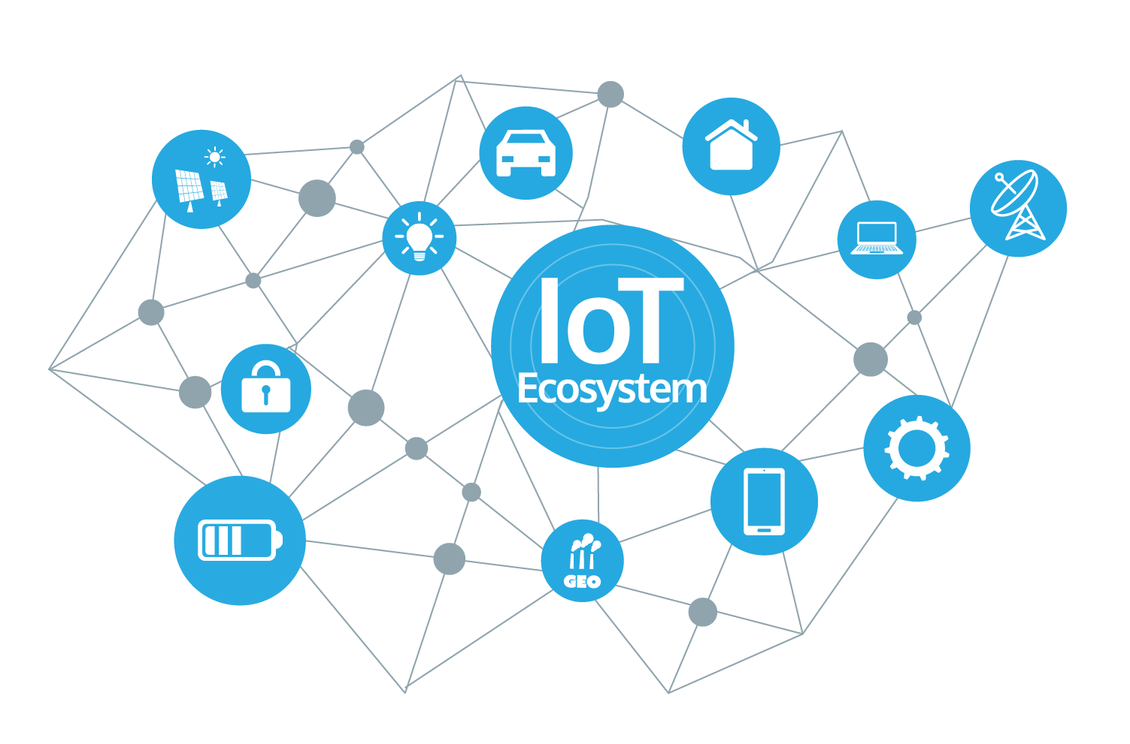
What is Internet of Things?
The internet of things, or IoT, is a system of interrelated computing devices, mechanical and digital machines, objects, animals or people that are provided with unique identifiers (UID) and the ability to transfer data over a network without requiring human-to-human or human-to-computer interaction.
It is also referred as Machine to Machine (M2M), Skynet, Internet of Everything.

Slide 3
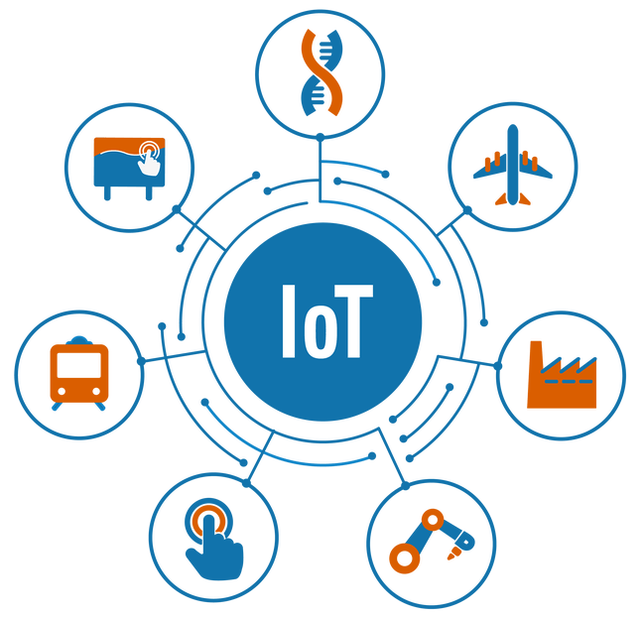
What is Things?
A thing in the internet of things can be a person with a heart monitor implant, a farm animal with a biochip transponder, an automobile that has built-in sensors to alert the driver when tire pressure is low or any other natural or man-made object that can be assigned an IP address and is able to transfer data over a network.

Slide 4
Inventor of the term Internet of Things:
Kevin Ashton, co-founder of the Auto-ID Center at MIT, first mentioned the internet of things in a presentation he made to Procter & Gamble (P&G) in 1999.
Although Ashton's was the first mention of the internet of things, the idea of connected devices has been around since the 1970s, under the monikers embedded internet and pervasive computing.

Slide 5
Why IoT?
It enables devices/objects to observe, identify and understand a situation or the surroundings without being dependent on human help.
When devices/objects can represent themselves digitally, they can be controlled from anywhere. The connectivity then helps us capture more data from more places, ensuring more ways of increasing efficiency and improving safety and IoT security.
IoT is a transformational force that can help companies improve performance through IoT analytics and IoT Security to deliver better results

Slide 6
Some advantages of IoT:
Automation: Which leads to uniformity in tasks, quality of service and control of day-to-day tasks without human intervention. Machine-to-machine communication also helps maintain transparency throughout the process.
Efficiency: Machine-to-machine interaction provides for better efficiency, enabling people to focus on other jobs.
Cost Savings: In addition to the optimal utilization of energy and resources, the IoT helps alleviate the problems associated with bottlenecks, breakdowns and system damages.
Communication: IoT allows physical devices to stay connected and better communicate, which creates greater quality control.
Instant Data Access: More available information helps simplify the decision making process, making life easier to manage.

Slide 7
Some advantages of IoT: (Contd.)
Data: The more the information, the easier it is to make the right decision. Knowing what to get from the grocery while you are out, without having to check on your own, not only saves time but is convenient as well.
Tracking: The computers keep a track both on the quality and the viability of things at home. Knowing the expiration date of products before one consumes them improves safety and quality of life. Also, you will never run out of anything when you need it at the last moment.
Time: The amount of time saved in monitoring and the number of trips done otherwise would be tremendous.
Money: The financial aspect is the best advantage. This technology could replace humans who are in charge of monitoring and maintaining supplies.

Slide 8
How IoT works?
There are two major subsystems involved in the IoT network viz. front end part and back end part. Front end is mainly consists of IoT sensors which are MEMS based. It includes optical sensors, light sensors, gesture and proximity sensors, touch and fingerprint sensors, pressure sensors and more.
Back end consists of cellular, wireless and wired networks which are interfaced with IoT devices. The devices will report to the central servers and also interact with databases in the backbone network. Routers and gateways are part of the wireless backbone networks.

Slide 9
IoT projects (basic):
IoT Based Humidity and Temperature Monitoring Using Arduino Uno
IoT Connected Healthcare Applications
IoT Based Intelligent Traffic Management System
IoT Based Smart Parking System Using RFID
IoT Based Smart Waste Management System for Smart City
IoT Smart Home automation using Node Mcu

Slide 10
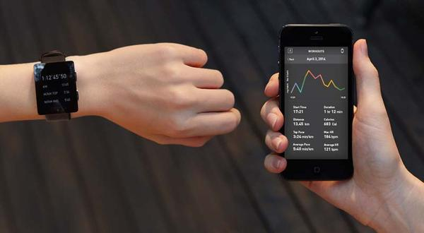
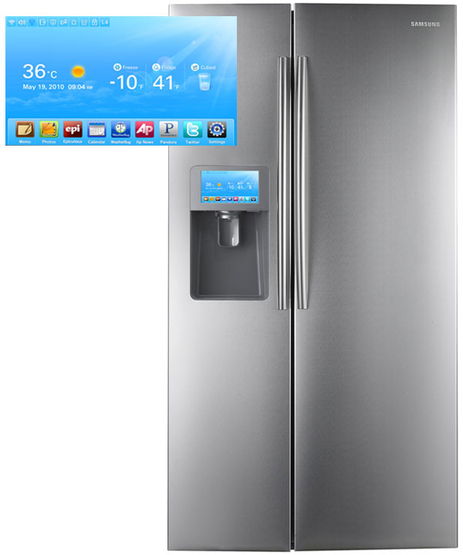
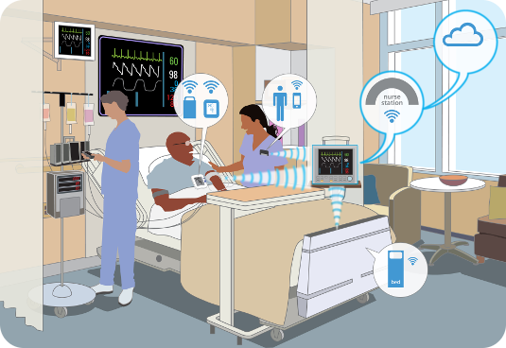
IoT Implementation:
Smart Appliances
Wearable Tech
Healthcare

Slide 11
Thank you

